Slide 1
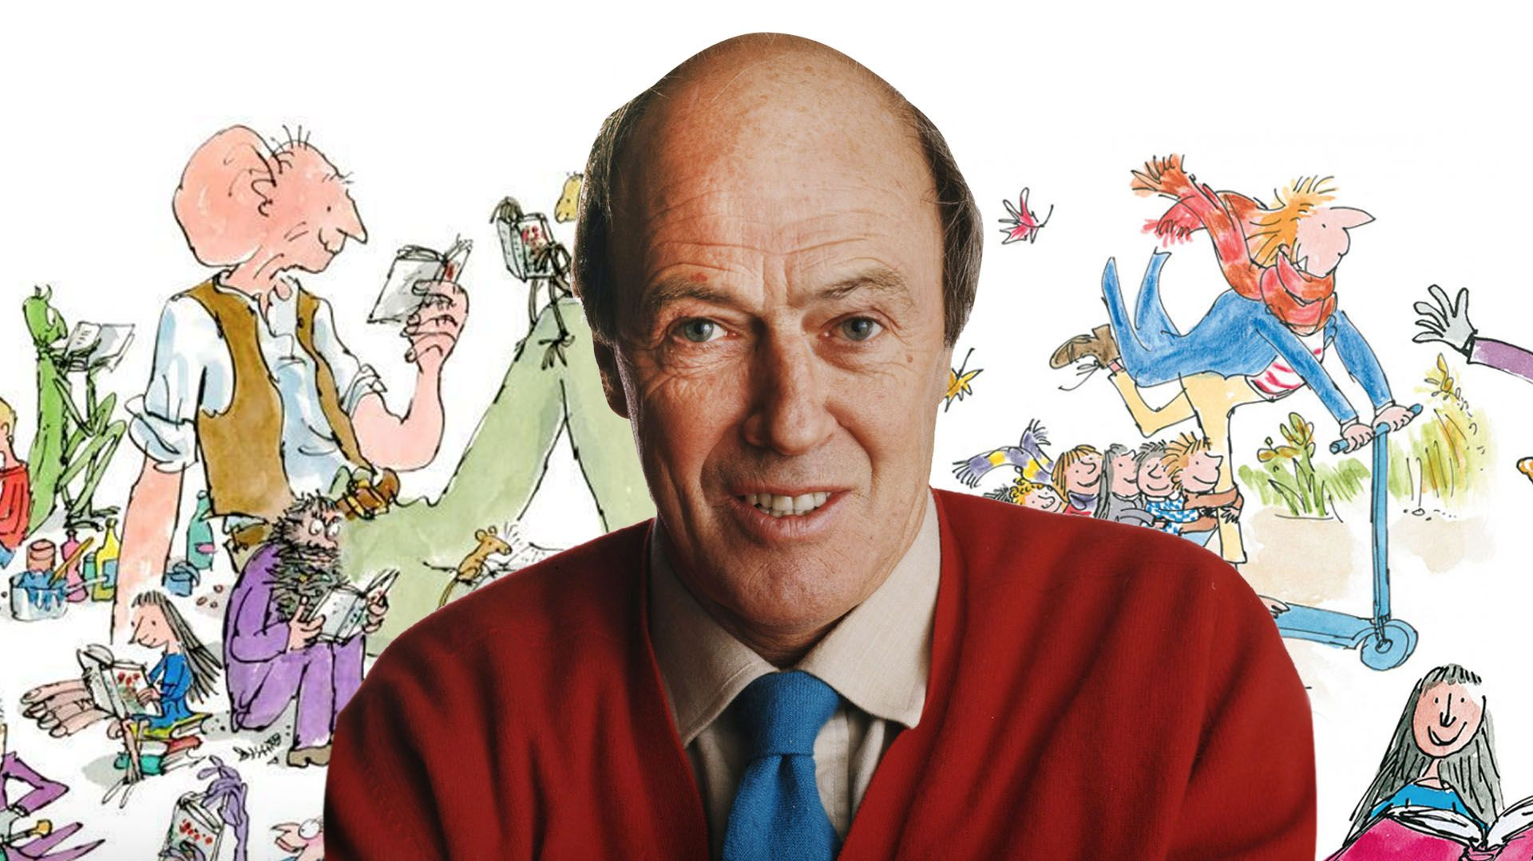

Slide 3
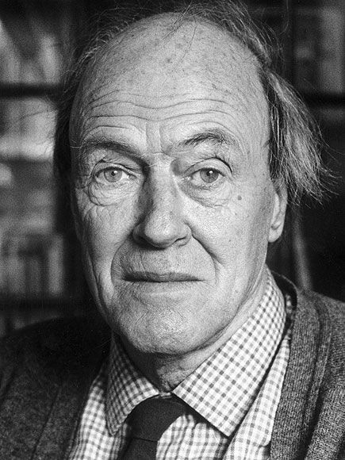
DAHL
ROALD

Slide 4
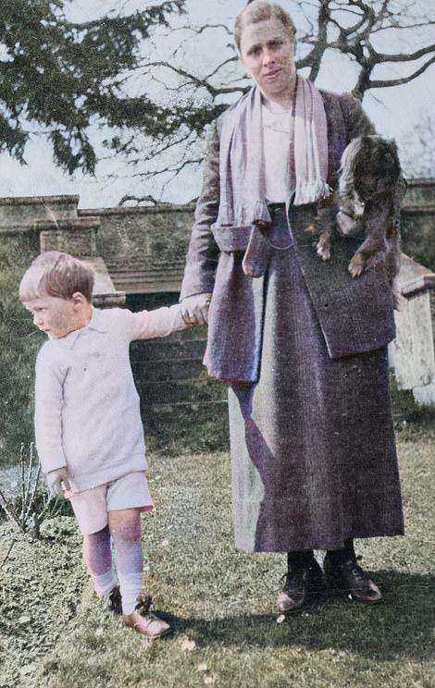
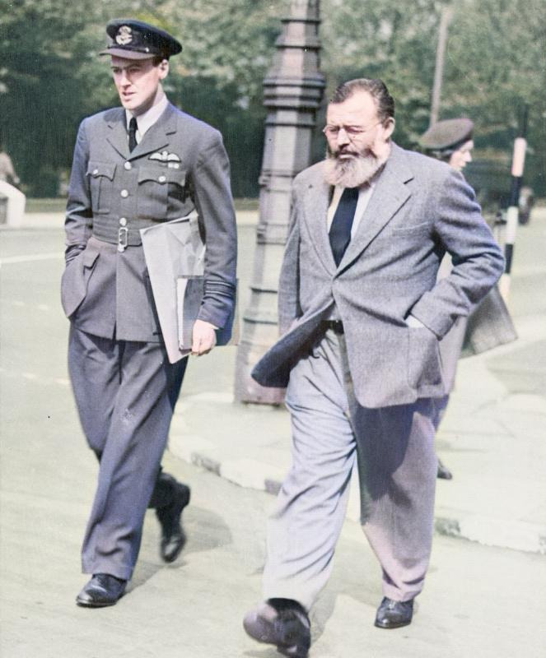
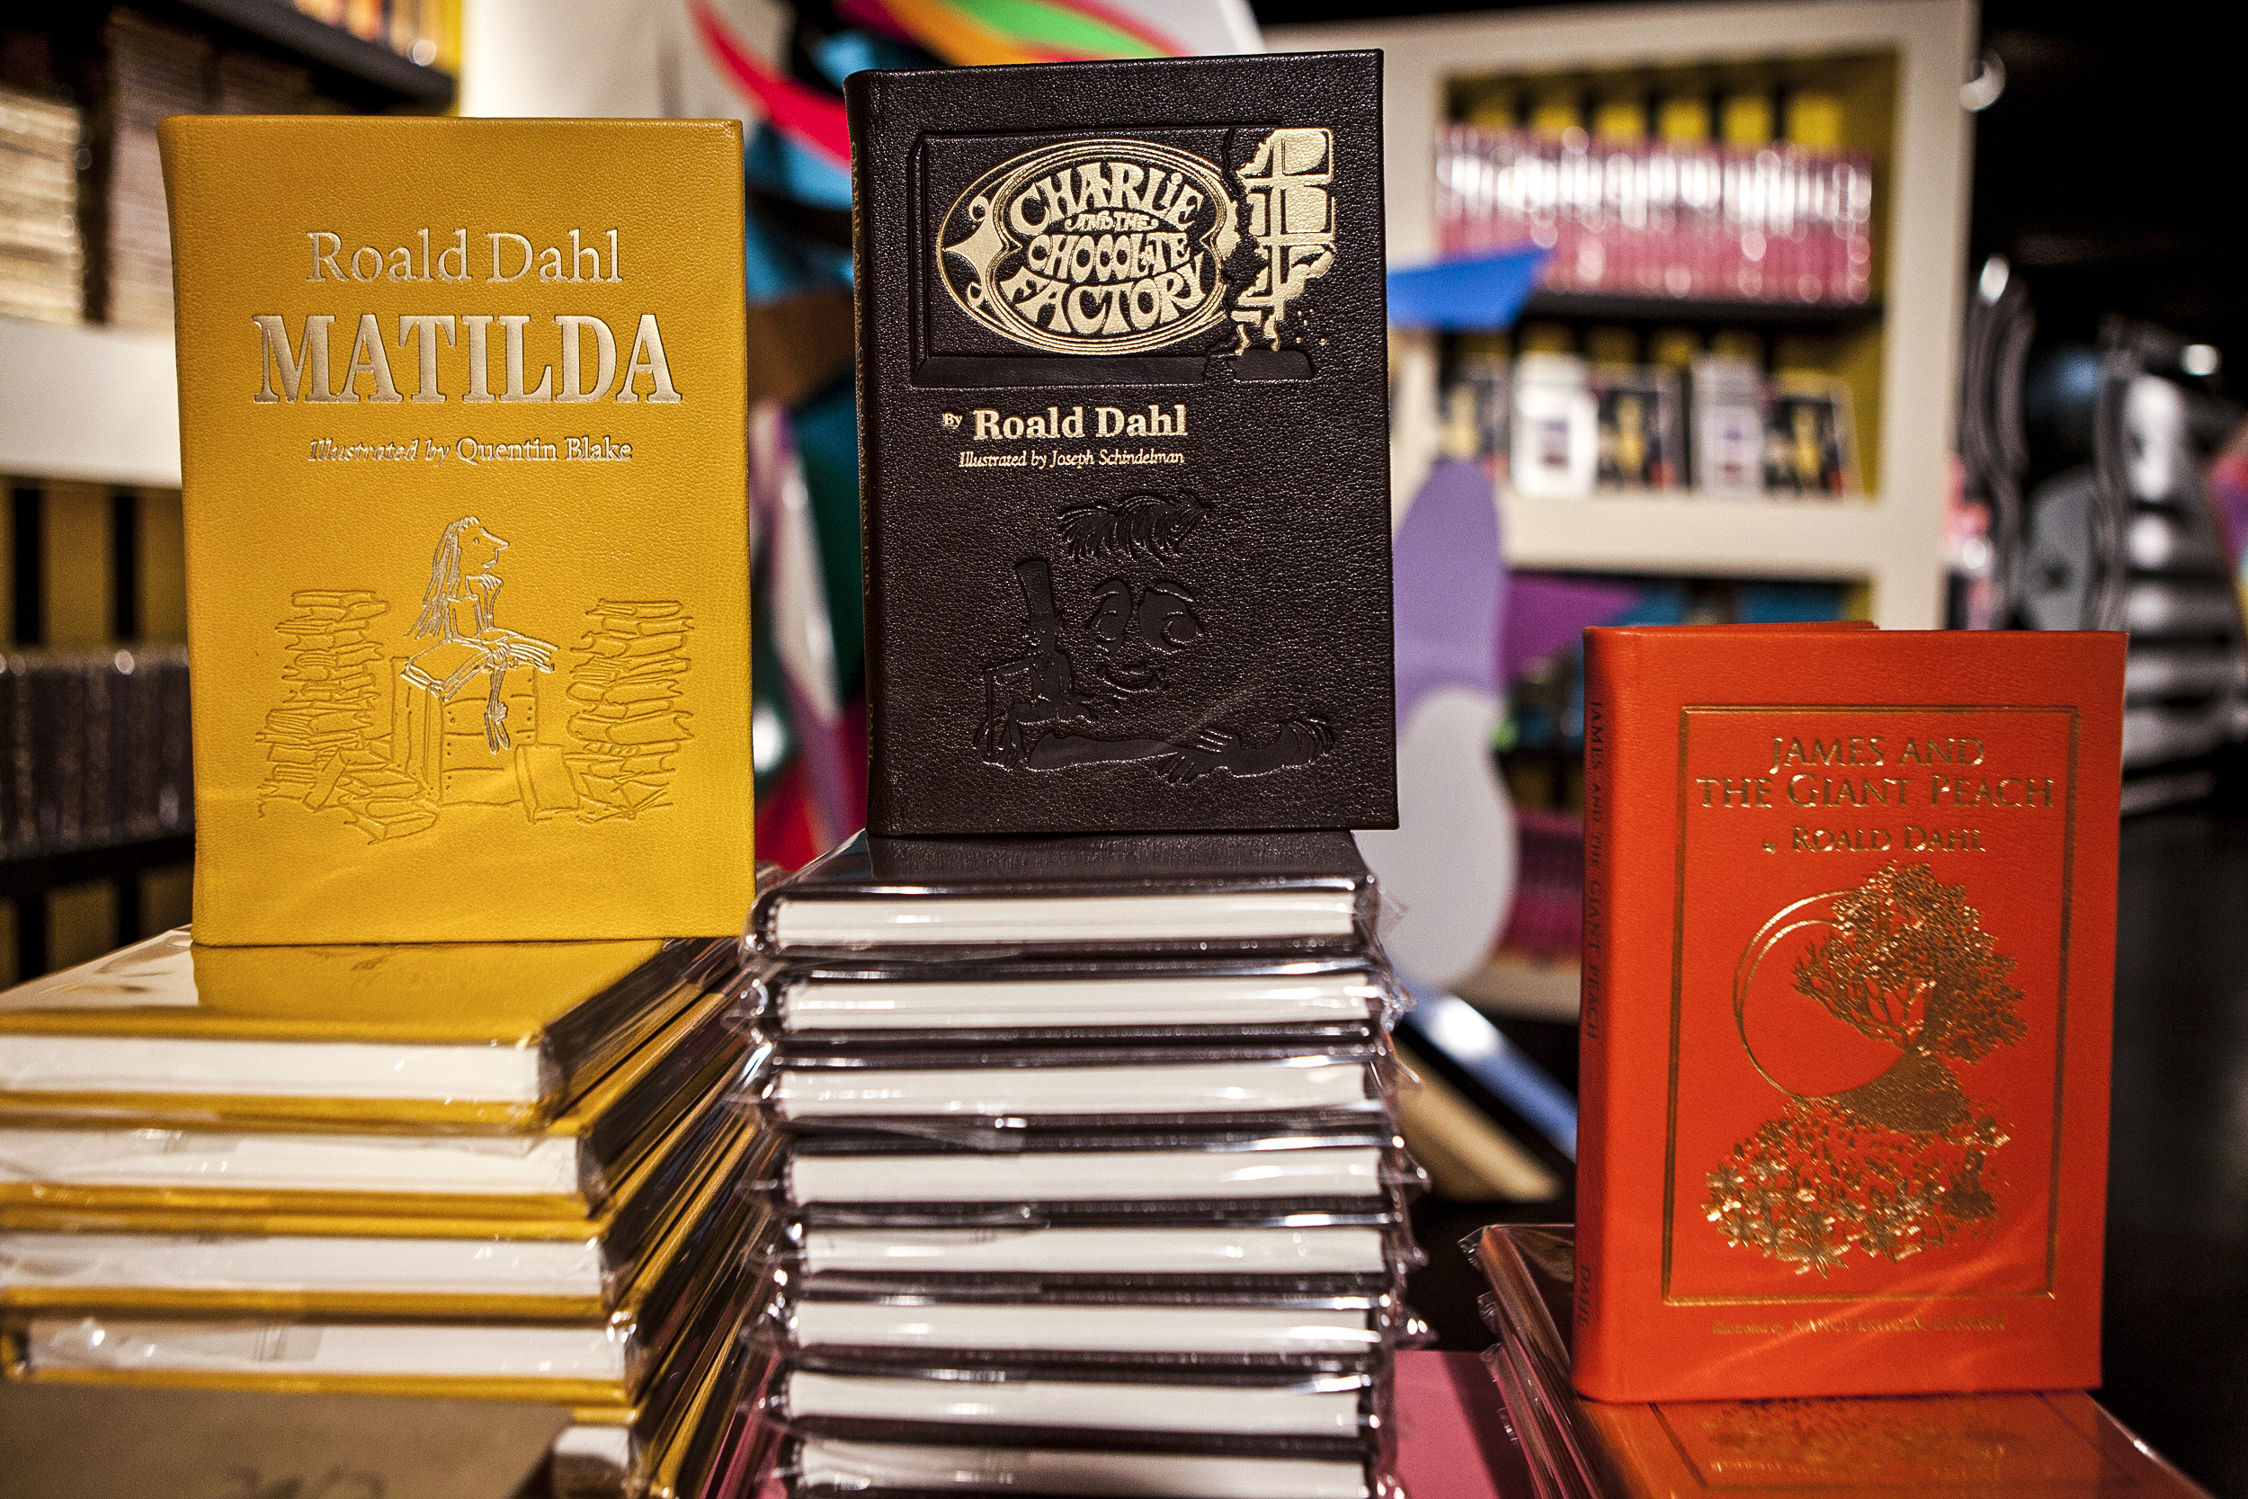
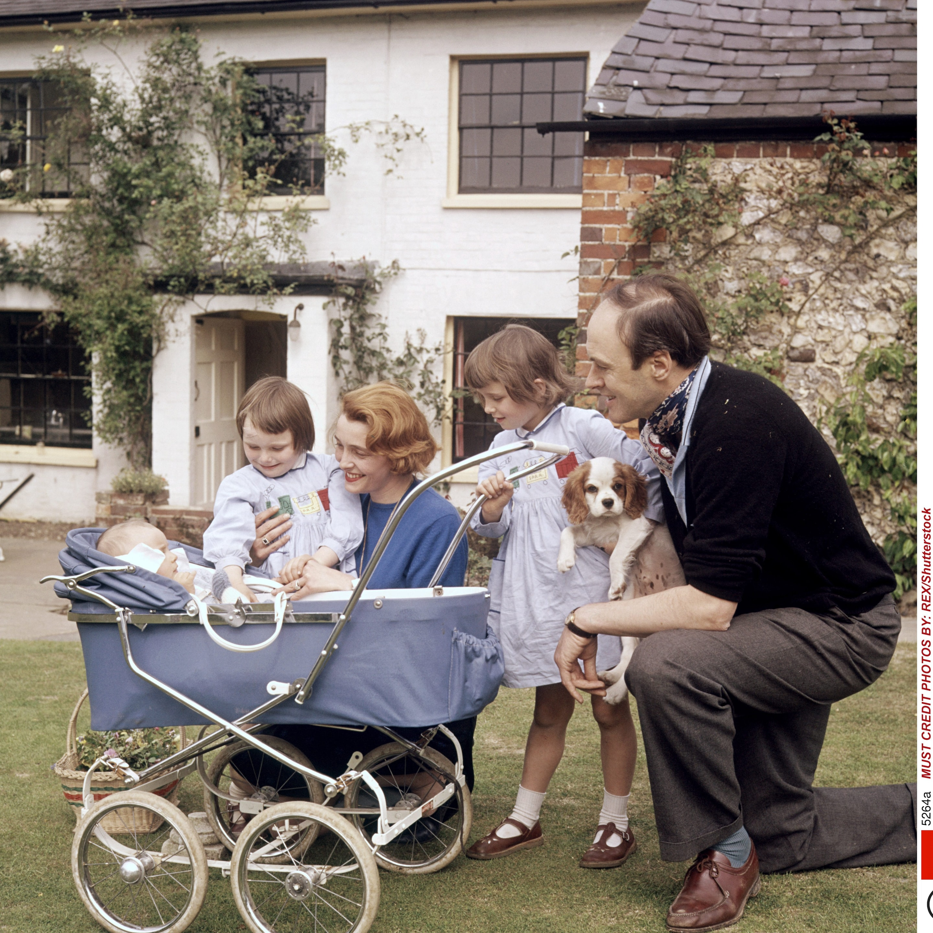
ROALD DAHL
HIS LIFE…. IN PICTURES
BRITISH PHENOMENOM

Slide 5
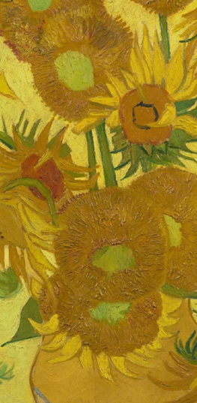

ROALD DAHL
ROALD DAHL
IN HIS CHILDHOOD
Born in Wales in 1916 to Norwegian immigrant parents.
Born into a financially well off family.
Completed formal education in England.
Was in the British army, air force and even fought in World War II
Sold more than 300 million copies worldwide.
1916-1990

Slide 6
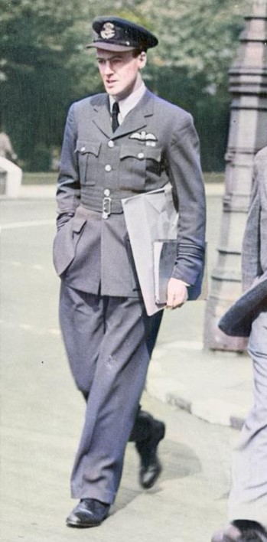

ROALD DAHL
Outline to his character
One of the greatest writer of children books whose works to this day have dictated the baseline to writing for children.
He invented more than 500 new words and character names.
Was an ecstatic and lively man, full of enthusiasm
Used to spend more than 200 pounds monthly just replying to the mail of the children that wrote to him.
PEAK CREATIVITY
Dahl with Ernest Hemingway, London
[1944]

Slide 7

ROALD DAHL
Outline to his character
Dahl’s popular works
One of the greatest writer of children books whose works to this day have dictated the baseline to writing for children.
He invented more than 500 new words and character names.
His books were influenced heavily by his childhood experiences
Was an ecstatic and lively man, full of enthusiasm
Wrote Charlie and the Chocolate Factory, James and the Giant Peach, Fantastic Mr. Fox., The Witches and many more
Used to spend more than 200 pounds monthly just replying to the mail of the children that wrote to him.
PEAK CREATIVITY
Dahl with Ernest Hemingway, London
[1944]
“Great things often start off small.”
-DAHL
He never learned to type

Slide 8
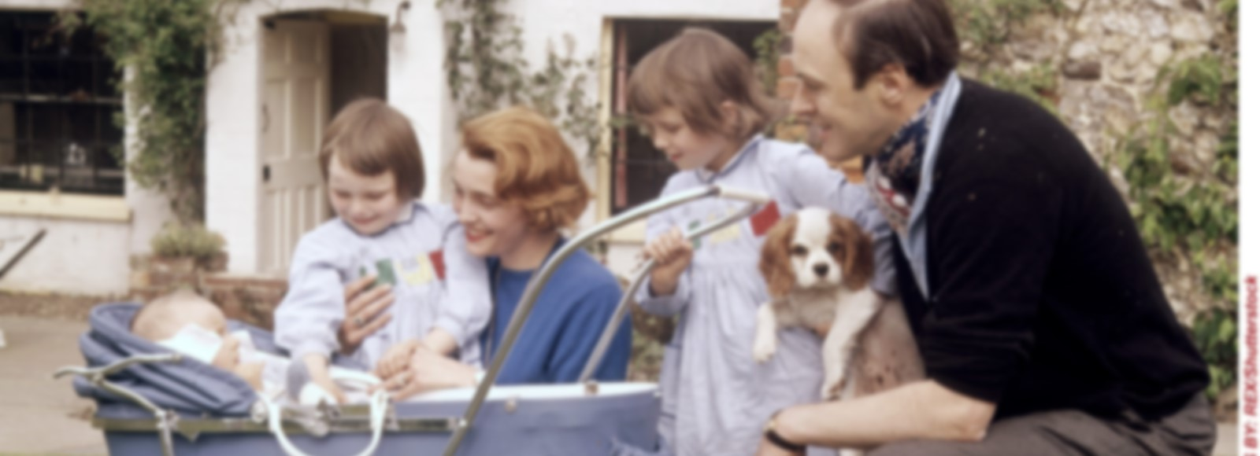
ROALD DAHL
LATER LIFE OF DAHL
Dahl’s popular works
After Dahl’s army endeavors, he met C.S. Forester, his inspiration in literature. Slowly he started writing and got recognition and success.
Dahl married Hollywood actress Patricia Neal and had 5 children.
His books were influenced heavily by his childhood experiences
He lost his daughter to measles and his wife had 3 strokes. He was later also divorced and married Felicity Crossland.
Wrote Charlie and the Chocolate Factory, James and the Giant Peach, Fantastic Mr. Fox., The Witches and many more
Despite all the pushbacks, his continuous and routine efforts pushed him forward.
Dahl collected paintings, furniture and appreciated fine wine.
He died in 1990.
“Great things often start off small.”
-DAHL
He never learned to type
FAMILY
PASSED AWAY IN 1990

Slide 9


CHARACTERS

Slide 10
THE MOTHER
The mother of the unnamed child only appears at the end, not playing significant part in the story but rather a symbolical one.

Slide 11
THE child
An unnamed child is the dominant character in the story. His naïve imagination shows that he must be very young and ripe.

Slide 12
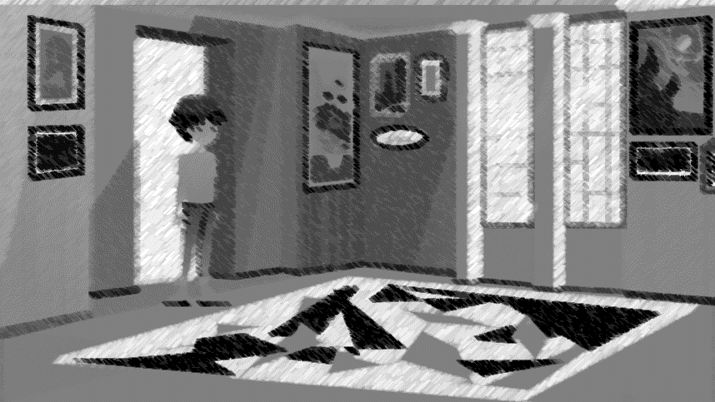
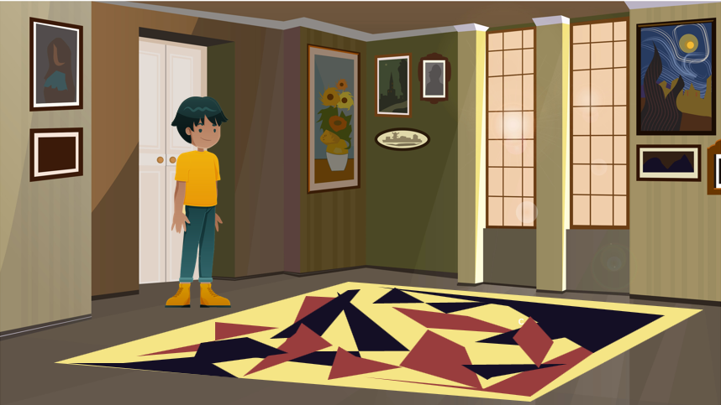
SETTING

Slide 14
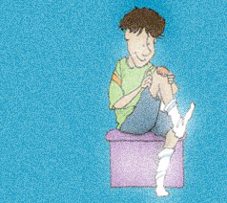


Slide 15
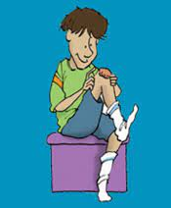
The Plot unfolds with the boy picking up the scab in his leg.

Slide 16
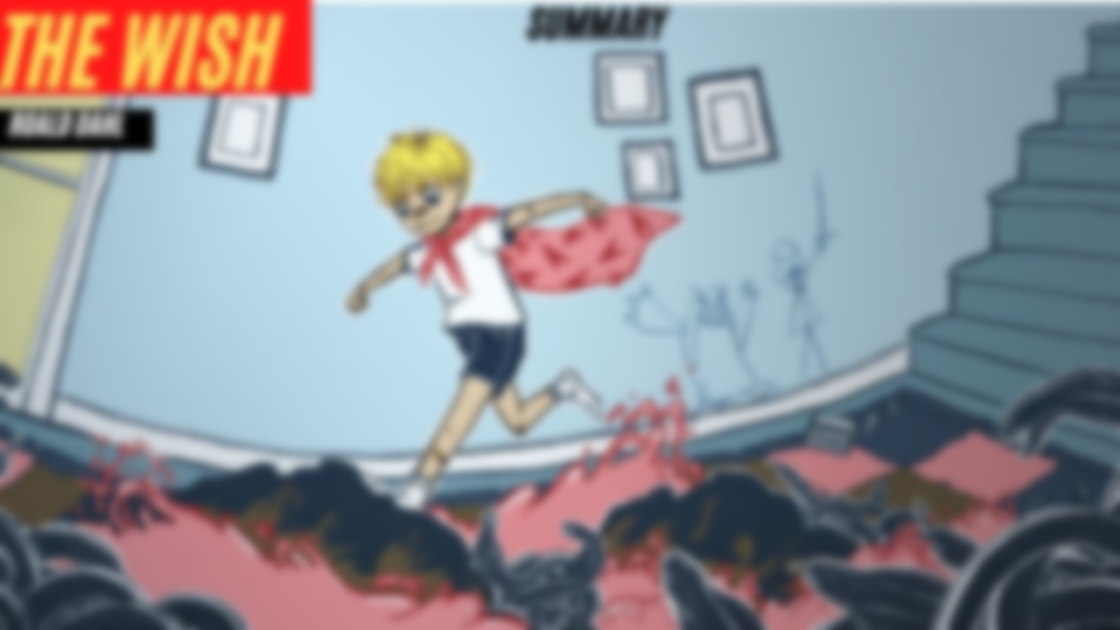


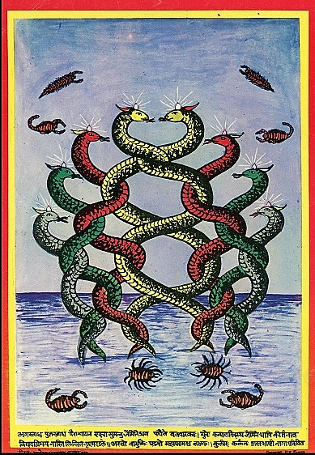

Slide 17



Slide 18
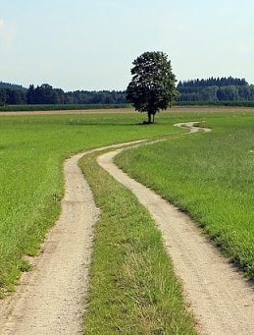

Slide 19


Slide 20
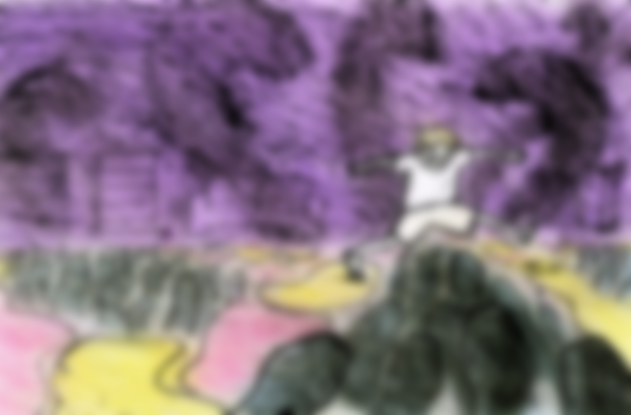

BLACK PART REPRESENT
Venomous snakes

Slide 21
RED PART REPRESENT
RED HOT COAL

Slide 22
YELLOW PART REPRESENT
SAFE ZONE

Slide 23
YELLOW PART REPRESENT
SAFE ZONE

Slide 24

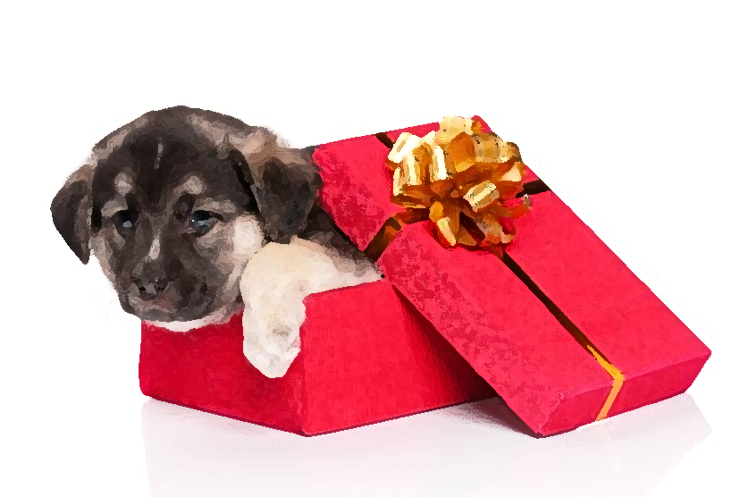

Slide 25
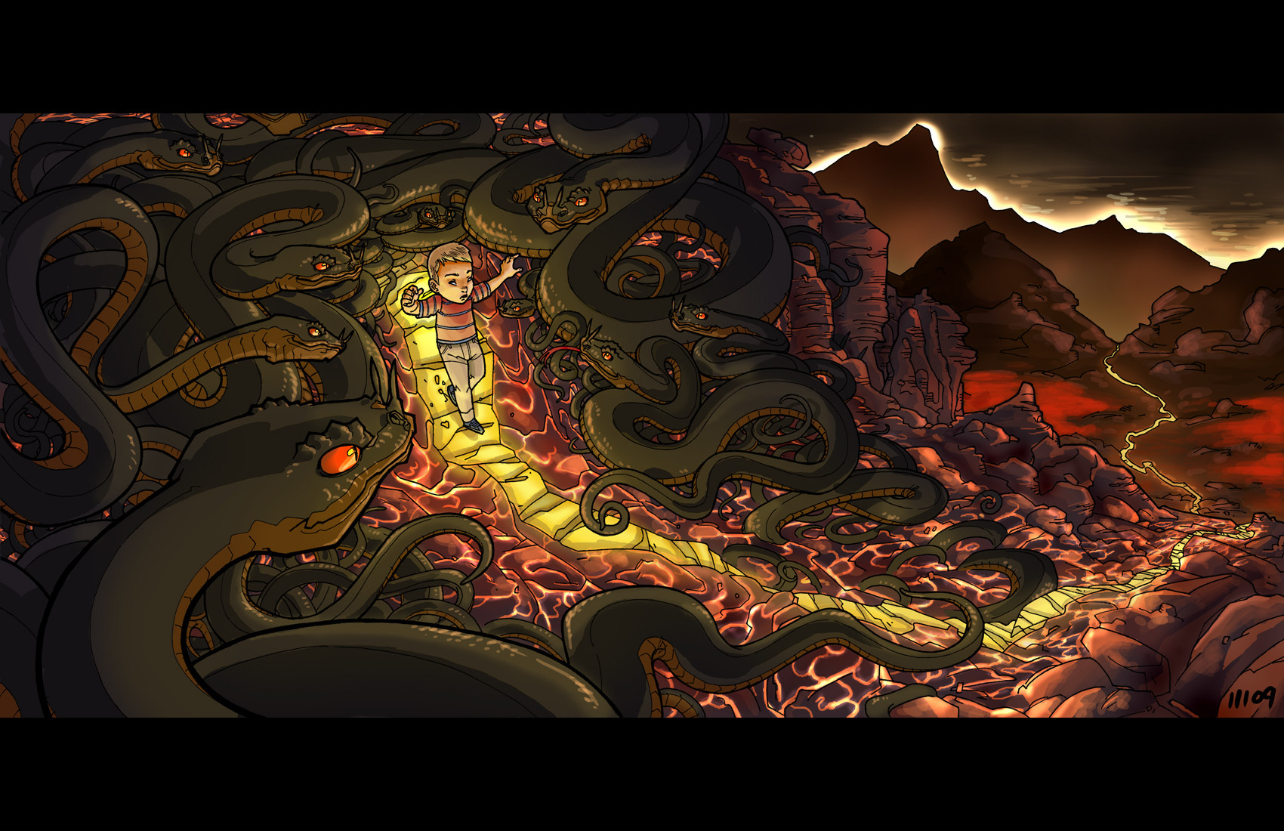

Slide 26






THEMES

Slide 27


CONFIDENCE
THEMES

Slide 28

imagination
THEMES

Slide 29
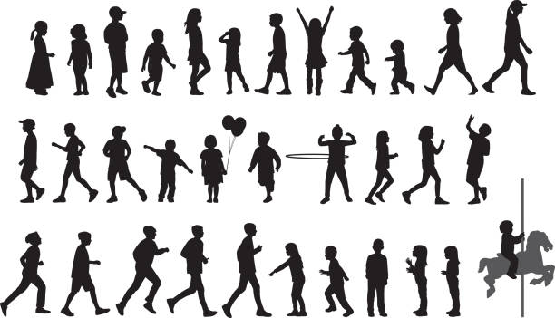
Innocence of children
THEMES

Slide 30

finding the right path
THEMES

Slide 31

STEPPING OUT OF COMFORT ZONE
THEMES

Slide 32

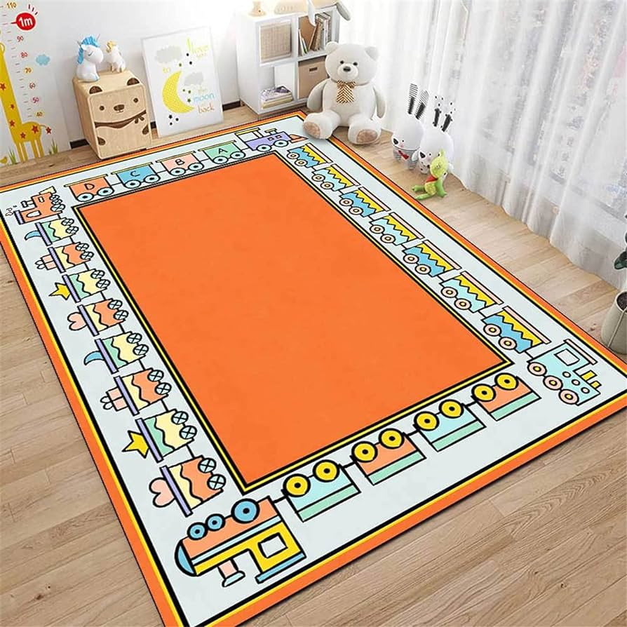
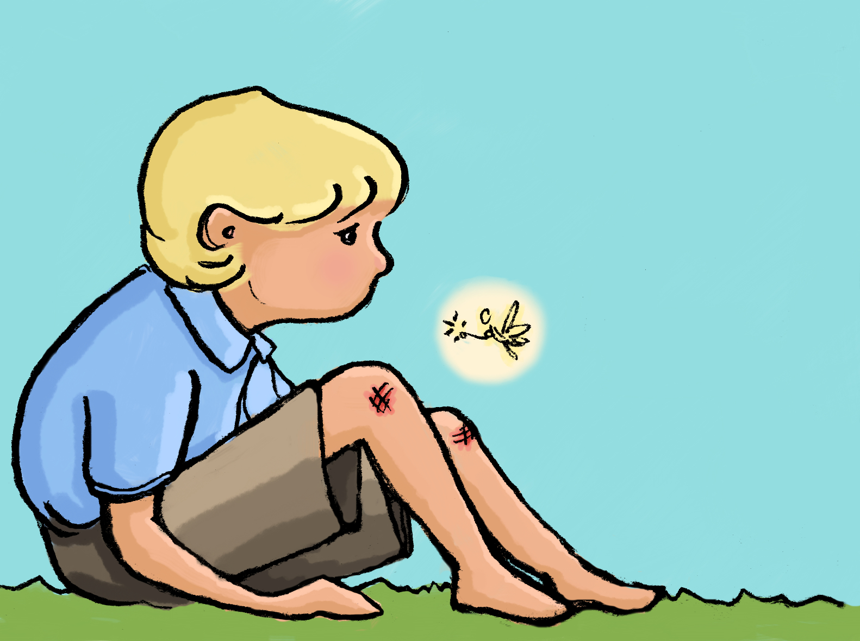

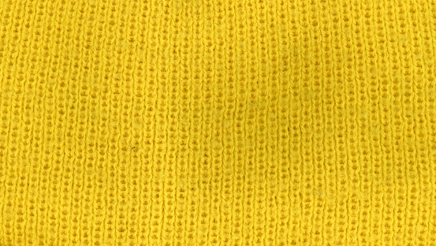
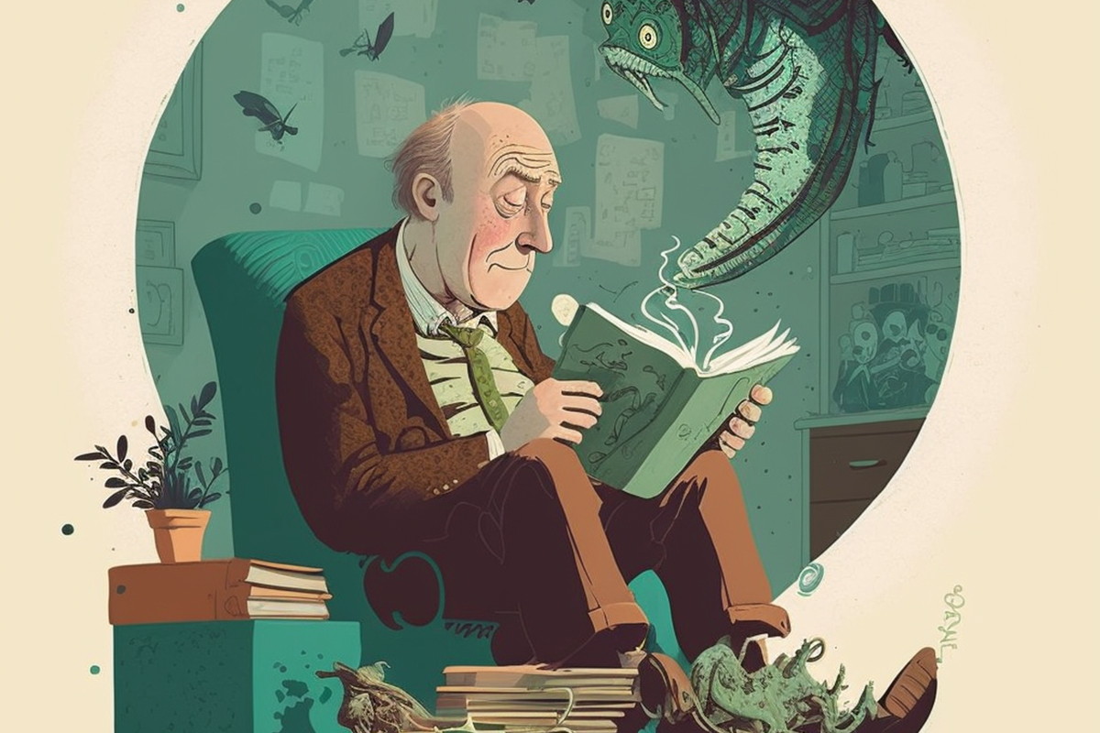
SYMBOLS

Slide 33
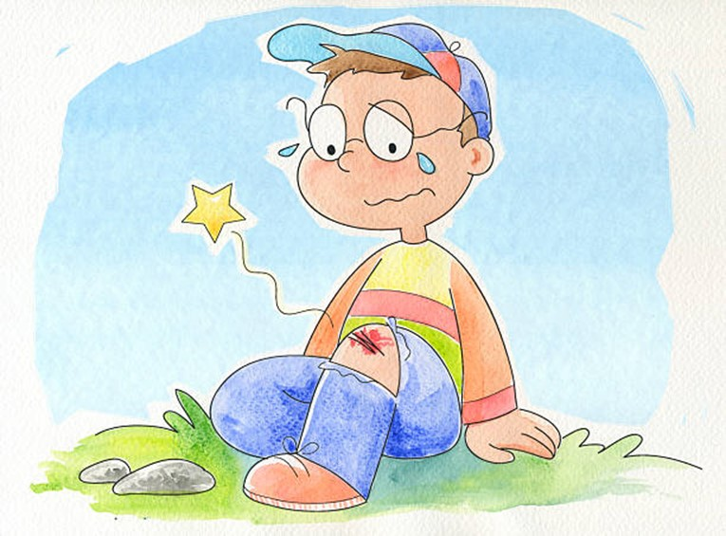
The scab
SYMBOLS

Slide 34
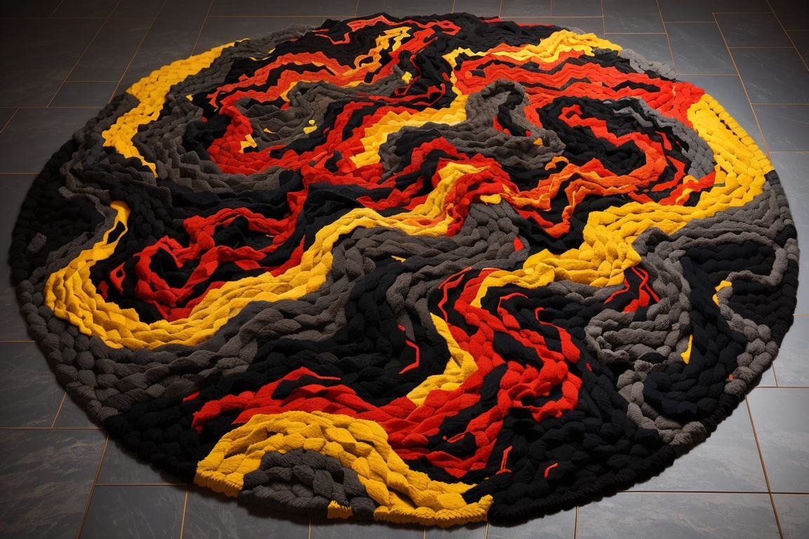
THE CARPET
SYMBOLS

Slide 35
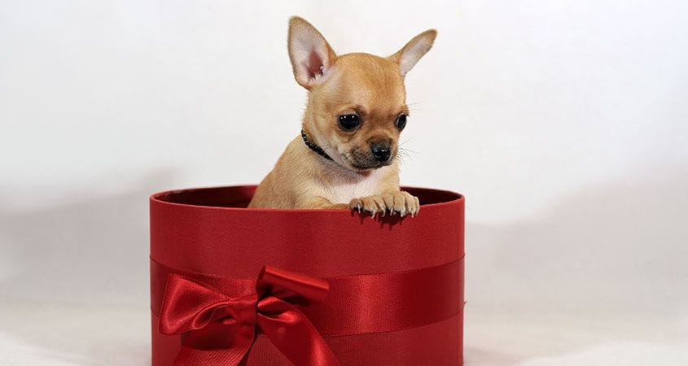
GIFT (the DOG)
SYMBOLS

Slide 36

Red and
SYMBOLS
Black portions

Slide 37

YELLOW PATCHES
SYMBOLS

Slide 38
Thank you

